Slide 1
Introduction to Database

Slide 2
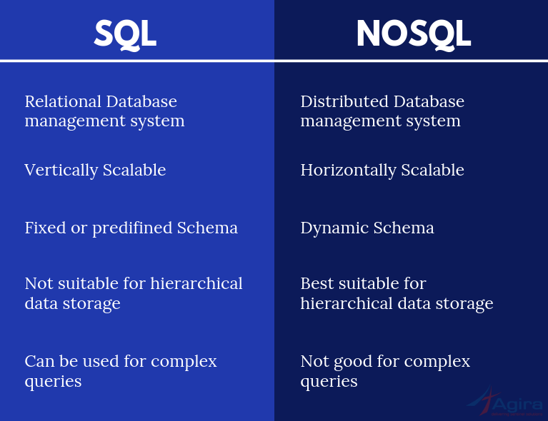
SQL vs NOSQL

Slide 3
what is MySQL and what are its features
MySQL is an open-source relational database management system. that uses tables as the main component.
MYSQL provides security and authentication client server execution and remote database access embedded SQL transaction control language

Slide 4
MongoDB
MongoDB is a source-available cross-platform document-oriented database program. Classified as a NoSQL database program, MongoDB uses JSON-like documents with optional schemas.
MongoDB is a document database used to build highly available and scalable internet applications. With its flexible schema approach, it’s popular with development teams using agile methodologies. Offering drivers for all major programming languages, MongoDB allows you to immediately start building your application without spending time configuring a database.

Slide 5
MongoDB vs MySQL
Feature | MySQL | MongoDB
Data Structure | It stores each individual record as a table cell with rows and columns | It stores unrelated data in JSON like documents
Schema | MySQL requires a schema definition for the tables in the database | MongoDB doesn’t require any prior schema
Languages | Supports Structured Query Language (SQL) | Supports JSON Query Language to work with data

